Slide 1
Link Prediction &
ROC / AUC
Seunghan Lee
2020-02-03

Slide 2
Contents
Link Prediction
1
- node2vec
Metric for evaluating Link Prediction
2
ROC
AUC

Slide 3
1. Link Prediction
node2vec

Slide 4
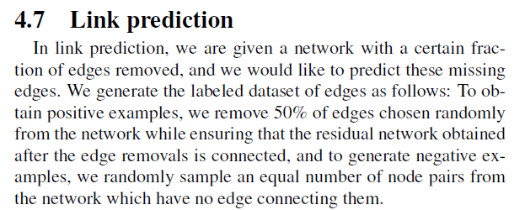
1. Link Prediction
( node2vec: Scalable Feature Learning for Networks )
Predict whether there is is a connection(link) between two nodes!
Binary Classification Problem!
Take one edge, and classify either into “connected” or “un-connected”

Slide 5
1. Link Prediction
( node2vec: Scalable Feature Learning for Networks )
Predict whether there is is a connection(link) between two nodes!
Binary Classification Problem!
Take one edge, and classify either into “connected” or “un-connected”
[Q] (in the case of weighted graph) Can’t it be a regression problem,
of predicting the “strength of the connection”( = weight ) ?

Slide 6
Link Prediction Algorithm
Network with edges & nodes
Masking ( Remove x% of edges )
Node2vec paper : mask 50%
[ INPUT ] Network with (100-x)% of edges
(removed) Network with x% of edges
train
test
Classification Model
( whether the edge is connected(1) or not(0) )

Slide 7
10 edges
5 edges left
( remove 5 edges (50%) )
MASKING
Remove x% of connected edges ( grey edge )
Train model only with the (100-x)% remaining edges ( black edge )

Slide 8
HOW?
MASKING
Remove x% of connected edges ( grey edge )
Train model only with the (100-x)% remaining edges ( black edge )

Slide 9
Black : remained
Grey : removed
Positive Sample
( remaining 50% edges )
1
5
2
3
4

Slide 10
Black : remained
Grey : removed
1
2
5
Negative Sample
( sampling UNCONNECTED nodes )
3
4

Slide 11
Black : remained
Grey : removed
Same number of pairs ( pos = neg )
Positive Sample
( remaining 50% edges )
1
1
2
4
5
2
3
5
Negative Sample
( sampling UNCONNECTED nodes )
4
3
4

Slide 12
Black : remained
Grey : removed
Same number of pairs ( pos = neg )
Positive Sample
( remaining 50% edges )
1
1
2
4
5
2
3
5
Negative Sample
( sampling UNCONNECTED nodes )
4
3
4

Slide 13
Black : remained
Grey : removed
1
1
Make a classification model
( with positive & negative sample )
* equal number of pairs
2
4
5
2
3
5
4
3
4

Slide 14
Black : remained
Grey : removed
test with Masked Edges!
( Predict these missing edges! )
[ACTUAL] 1
[PREDICTION] ?
test with Unconnected Edges!
( Predict these unconnected edges! )
[ACTUAL] 0
[PREDICTION] ?

Slide 15
Metric for evaluating
model performance in Link Prediction
1. ROC curve
2. AUC ( Area Under Curve )

Slide 16
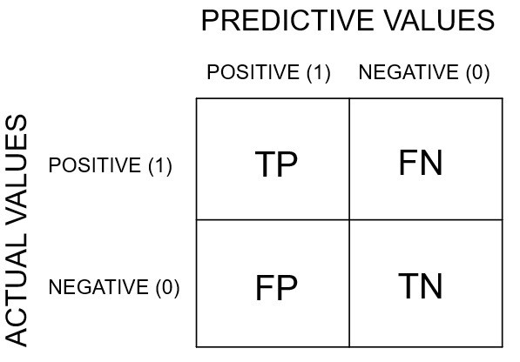
Before ROC & AUC…
Precision = TP / TP+FP ( Real Positive, among Predicted Positive )
Recall = TP / TP+FN
( Predicted Positive, among Actual Positive )
Specificity = TN / TN+FP
( Predicted Negative, among Actual Negative )
https://miro.medium.com/max/1194/0*wKaznIJzZF54b87B.jpg
[ Confusion matrix ]

Slide 17
Before ROC & AUC…
Precision = TP / TP+FP ( Real Positive, among Predicted Positive )
Recall = TP / TP+FN
( Predicted Positive, among Actual Positive )
Specificity = TN / TN+FP
( Predicted Negative, among Actual Negative )
https://miro.medium.com/max/1194/0*wKaznIJzZF54b87B.jpg
[ Confusion matrix ]

Slide 18
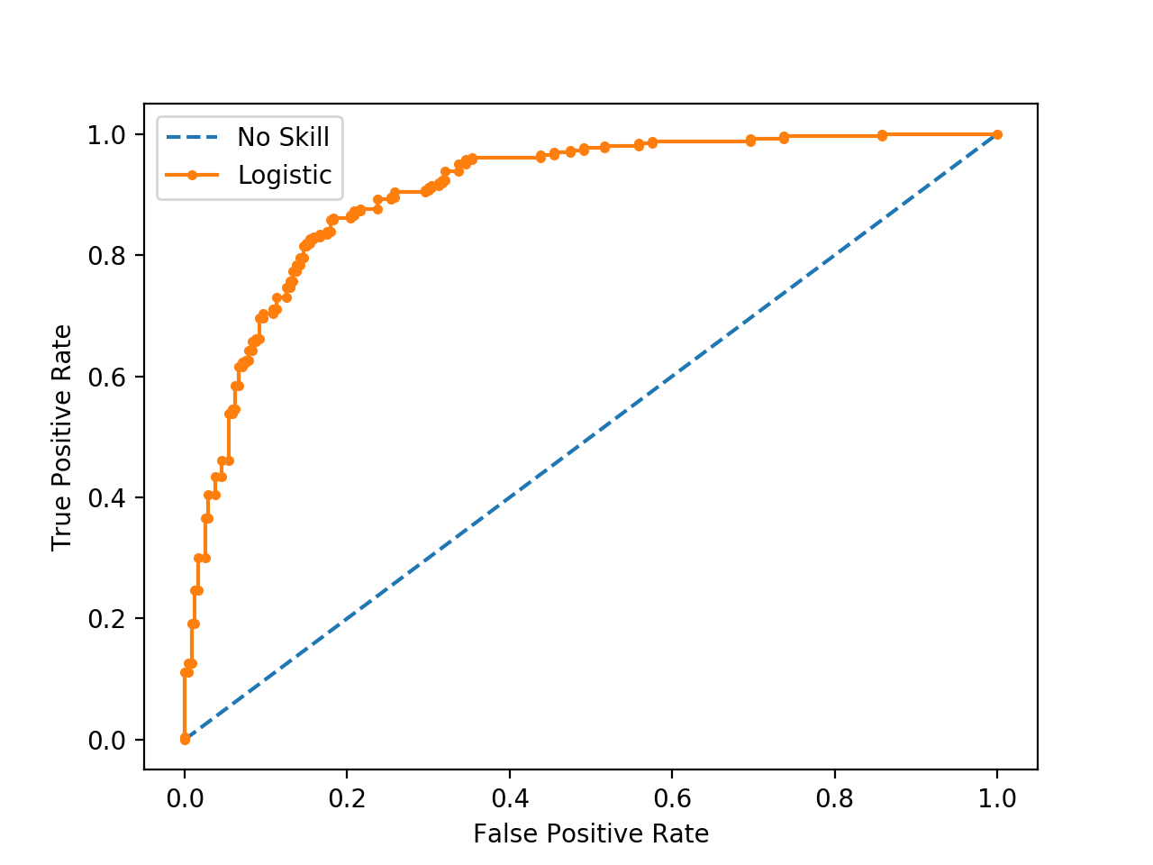
1. ROC Curve
( = FP / FP+TN)
X axis : False Positive Rate ( = 1 – Specificity )
The bigger, the better
( = TP / TP+FN)
Y axis : True Positive Rate ( = Recall )
The bigger, the better

Slide 19
1. ROC Curve
( = FP / FP+TN)
X axis : False Positive Rate ( = 1 – Specificity )
The greater the gap,
the better the classification
The bigger, the better
( = TP / TP+FN)
Y axis : True Positive Rate ( = Recall )
The bigger, the better

Slide 20
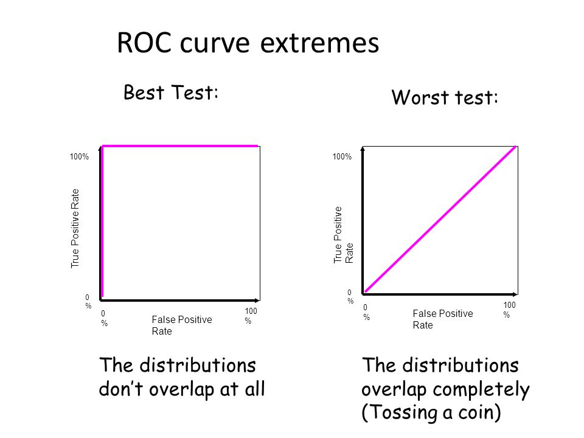
1. ROC Curve
( = FP / FP+TN)
X axis : False Positive Rate ( = 1 – Specificity )
The greater the gap,
the better the classification
The bigger, the better
( = TP / TP+FN)
Y axis : True Positive Rate ( = Recall )
The bigger, the better

Slide 21
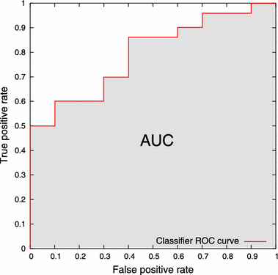
2. AUC ( Area Under Curve )
Area below the ROC curve!
( range : 0.5 ~ 1 )
* 0.5 : tossing a coin
https://media.springernature.com/original/springer-static/image/art%3A10.1007%2Fs10115-017-1022-8/MediaObjects/10115_2017_1022_Fig1_HTML.gif

Slide 22
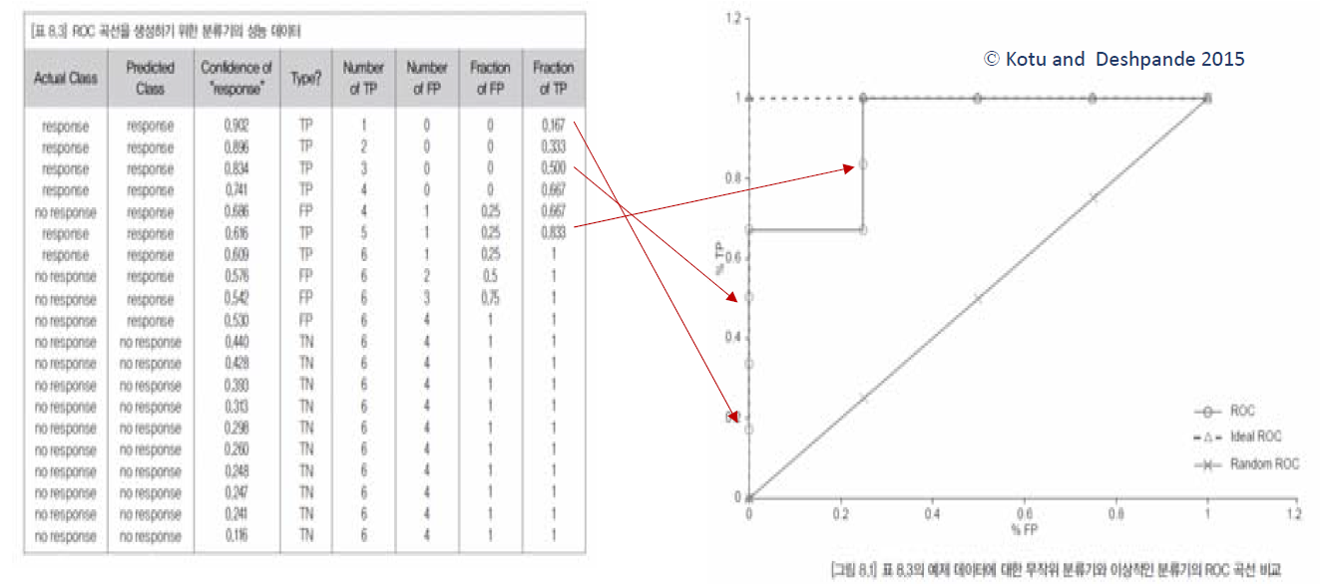
(optional) How to draw an ROC curve?

Slide 23
SUMMARY
1. Link Prediction
- Remove some edges with masking, for testing in the future!
- Make binary classification model with “remained positive edges” & “sampled negative edges”
- Predict the removed edges ( for testing )
2. ROC & AUC
Metric for evaluating binary classification model performance
ROC : checking how well a classification is done visually ( by comparing FPR & TPR )
AUC : checking how well a classification is done numerically, ( by finding the area under the ROC Curve )
(both ROC & AUC) the BIGGER, the BETTER

Slide 24
Thank you

